Slide 1
What can we learn from Northern Norwegian food traditions that can contribute to increased preparedness in times of crisis?
Marit Blekastad,
Kvæfjord Rural Women's Association
Notes:
My main focus will be on the food traditions of the last 50 years

Slide 2
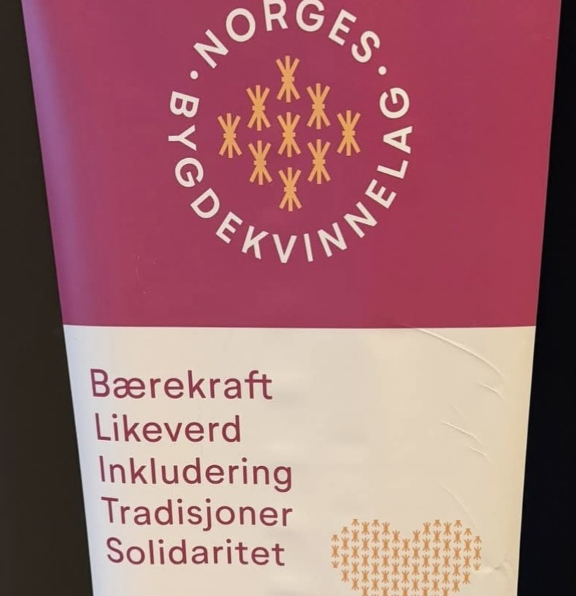
About Norwegian Rural Women's Association
Non-political organization with local chapters throughout Norway
Practical food knowledge, and inclusive local communities are two of our most important activities
Advisory organization for UNESCO on food traditions in Norway
In 2025, the Parliament asked the Government to enter into dialogue with, among others, the Rural Women's Association regarding our role as a food and care preparedness organization
Currently creating an idea bank regarding preparedness storage
Notes:
The words om the photo means: Sustainability, equality, inclusion, traditions, solidarity.
Those are the main points of the Norwegian Rural Women's Association

Slide 3
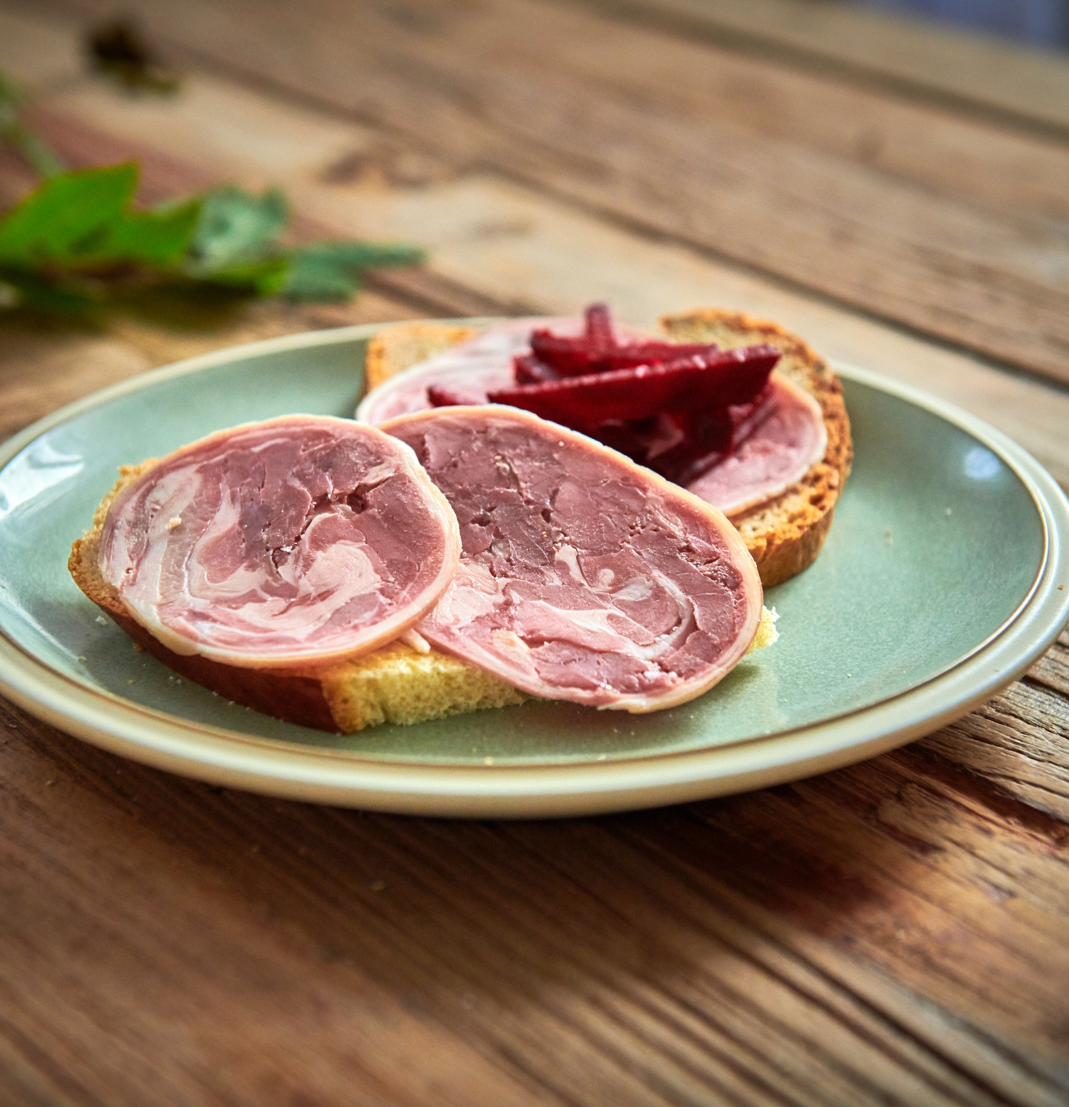
Norsktradisjonsmat.no
A website for traditional food recipes made by the Norwegian Rural Women's Association
contains traditional food recipes, pictures, videos
here is an example; how to sew kjøttrull/lammerull, the video was recorded in Kvæfjord (5 min 34 sek)
Https://norsktradisjonsmat.no/slik-lager-du-kjottrull/

Slide 4
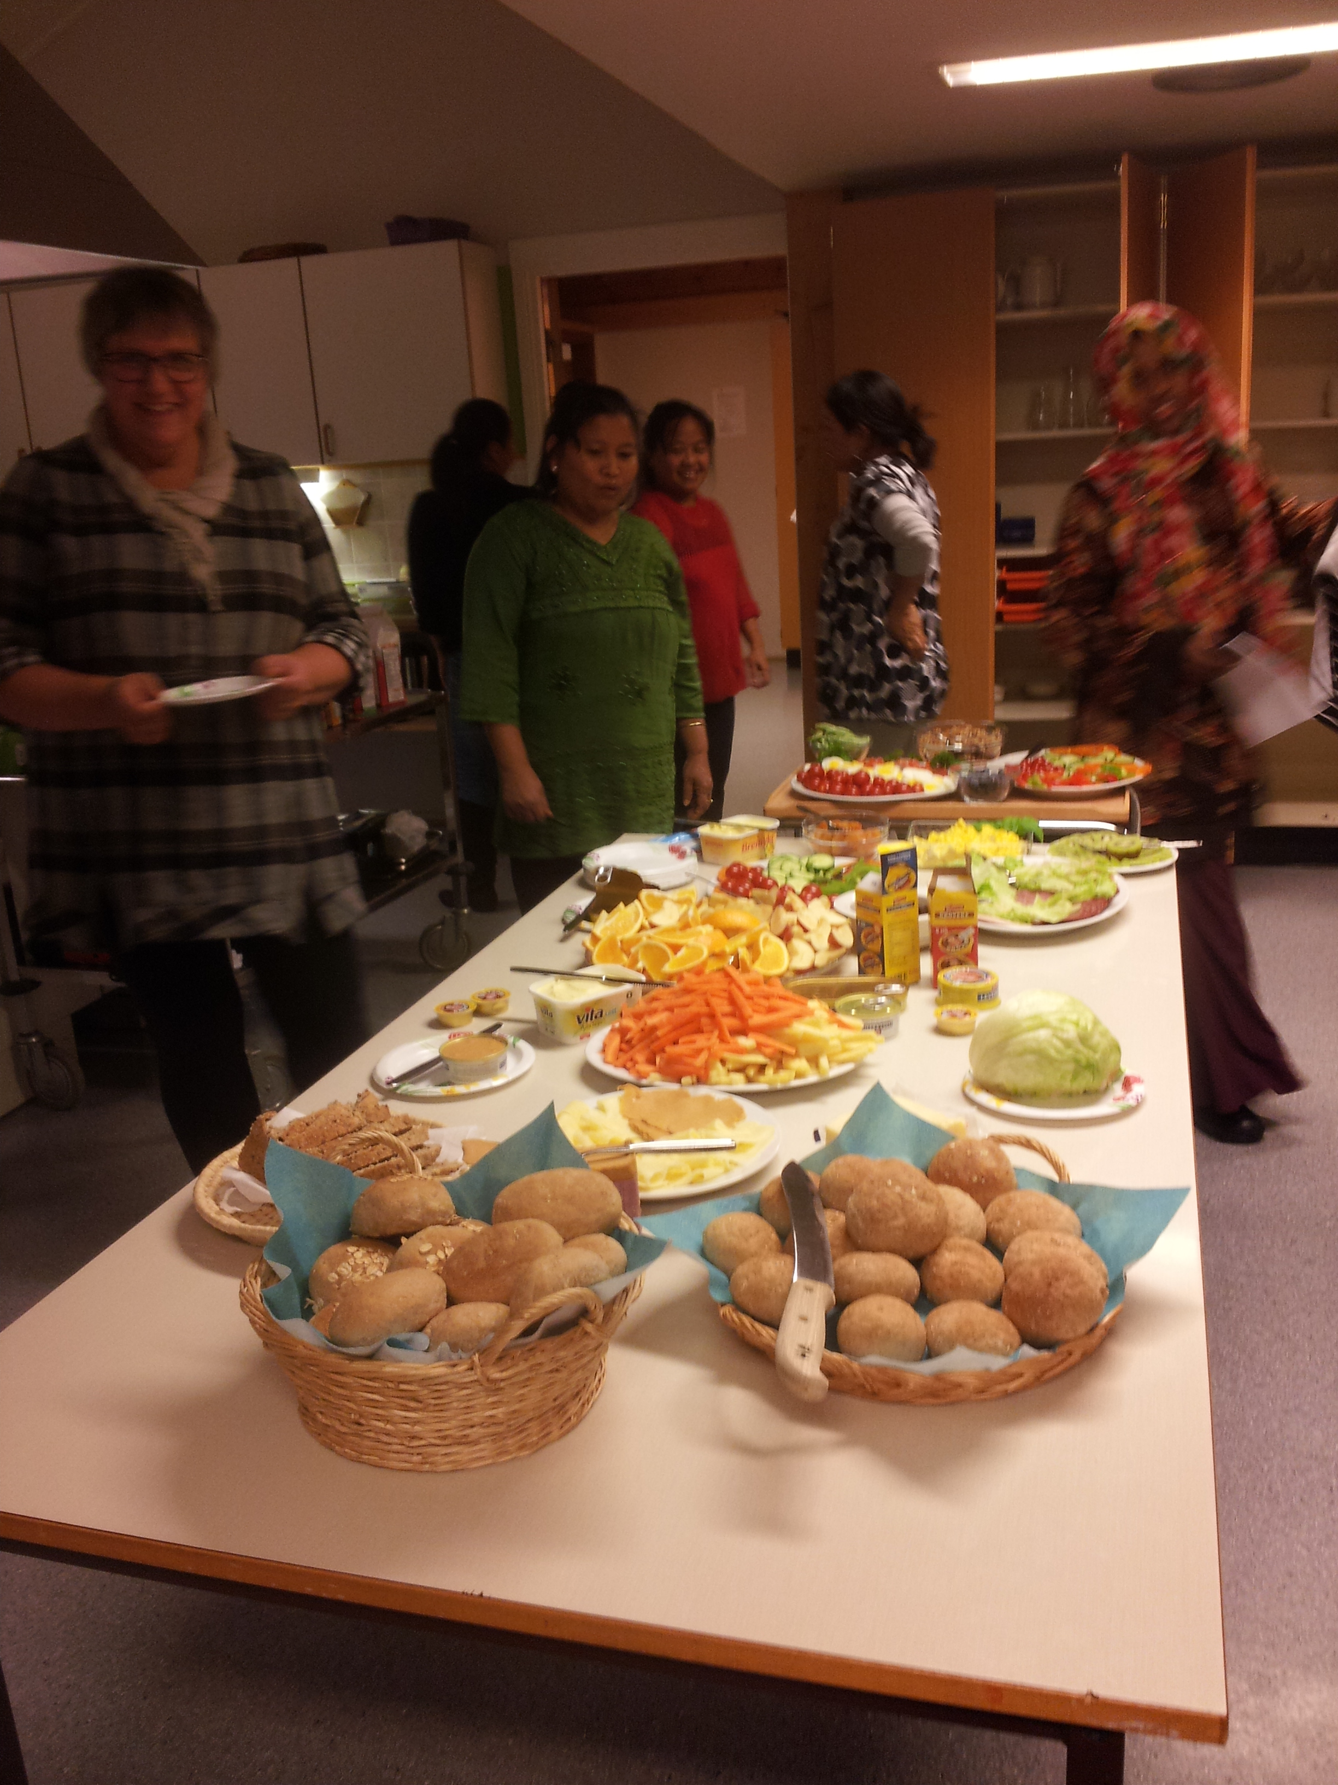
Kvæfjord Rural Women's Association
Local department
part of the municipal emergency preparedness council in Kvæfjord
Courses and training related to growing and foraging food
Cooking from scratch with local ingredients, food preservation, preparing food when the power is out
Motivating everyone to have their own emergency supplies
In October we will take part in the Norwegian self-activity week
Notes:
I am leader of Kvæfjord Rural Women's Association, and
live in Borkenes, a small village in the community of Kvæfjord, in Troms
Vesterålen, between Harstad in Troms and Sortland in Nordland county

Slide 5
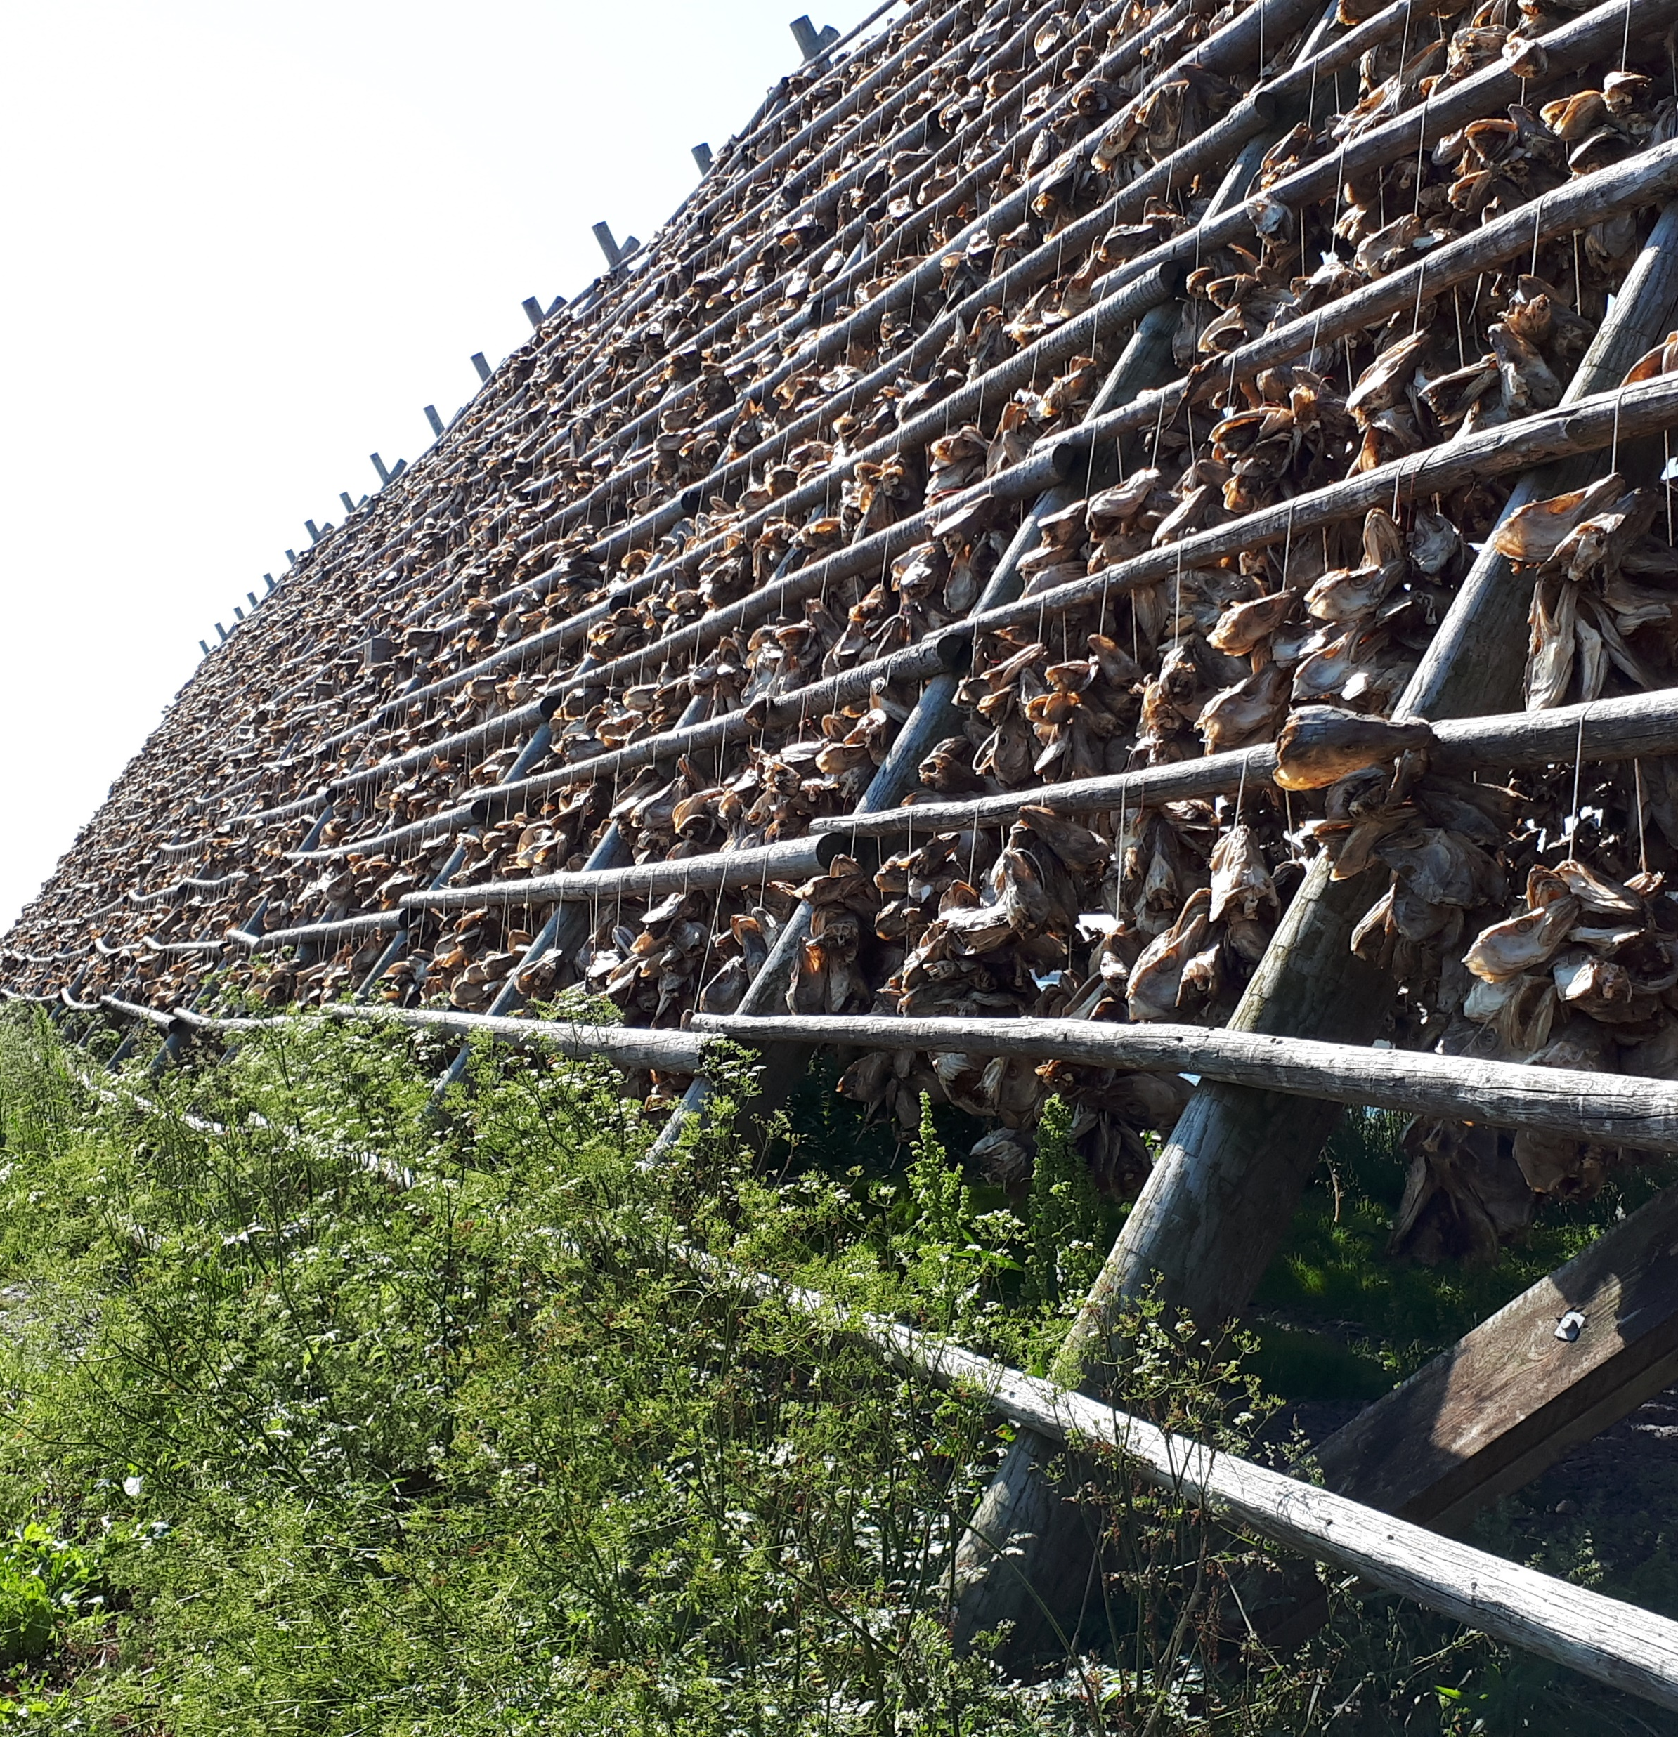
What is special about Northern Norwegian food traditions?
Based on local ingredients, homegrown or locally sourced (as other local communities had to in earlier times)
Fish (and potatoes) was THE important food
Before the freezer arrived, food “ in season”, fresh meat only during the slaughtering season, rest of the year the food was smoked, salted, dried so that it would be sustainable
Same with the fish,- but you can fish most of the year
Past use of spices was what was grown locally: caraway, parsley, thyme, chives, juniper berries,- and of course salt
Notes:
Karve, persille, timian, gressløk, einebær

Slide 6
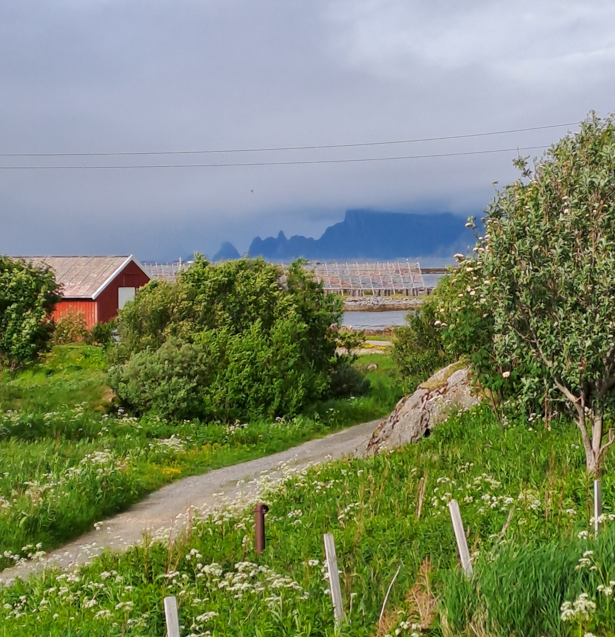
Fiskarbonden,- «the fish farmer»
The men went to sea during the fishing season to Lofoten and to Finnmark, while the women stayed home and looked after the animals, the farm, the children and the elderly who needed help
a primary family structure in subsistence farming in earlier days along the coast

Slide 7
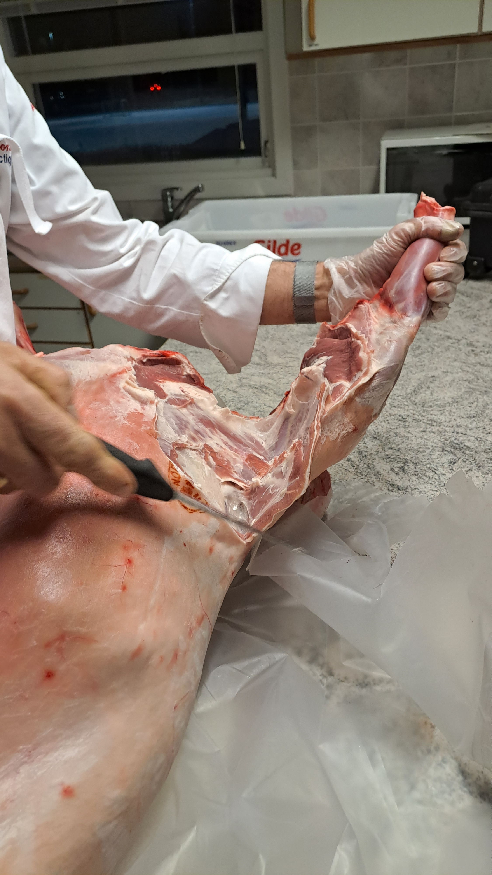
Types of food
Fish - along the coast, some freshwater fish inland
Meat - from grazing animals such as sheep, goats, wild animals ( reindeer, moose)
Vegetables/ potatoes: root vegetables (carrot, turnip)
Fruit/ berries: wild berries (blueberries, lingonberries, cloudberries), red currants, black currants
Other plants: wild plants, rhubarb
Milk/ dairy products: if they had a cow
Eggs, meat from hens (nowadays adult hens are being destroyed as there are no sales channels to get them into stores)
Notes:
Adult hens are now being destroyed as there are no sales channels to get them into stores. Everybody wants fastgrowing young chicken
Rhubarbplants outside every house… and still remains although the houses are gone

Slide 8
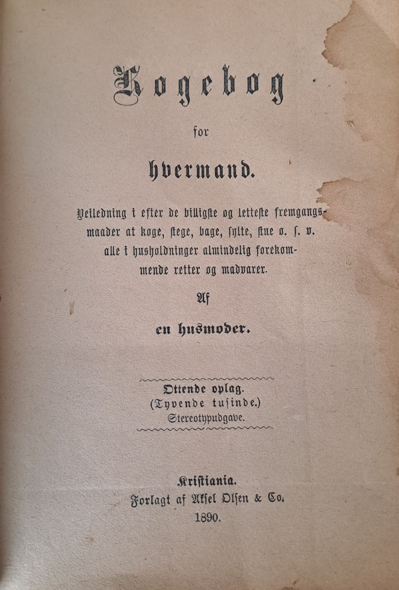
Weekly menu from Lofoten in the 1960s and 1970s
Dinner:
Monday: fresh boiled fish, potato soup (rhubarb, blueberries…)
Tuesday: fish balls in white sauce, potatoes soup
Wednesday: salted fish, potatoes soup
Thursday: fresh boiled fish, potatoes soup
Friday: fried fresh fish, potatoes soup
Saturday: fish gratin, potatoes soup
Sunday: meat (meatballs, small roast in brown sauce), potatoes prune compote with cream milk
Breakfast, mid-morning meal, evening meal: whole grain bread with cheese or jam (boiled egg on Sunday), milk, coffee, possibly porridge as a variation

Slide 9
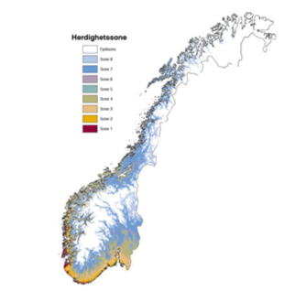
Northern Norway and climate zones
To understand our food traditions, one must think about what can be grown locally
Norway is approximately 1800 km from Lindesnes in the south to Nordkapp in the north
Nordland, Troms and Finnmark are 600-700 km in a straight line
The climate varies from climate zone H1 in the mildest climate zones in the south, to H8 and mountain zones in parts of Northern Norway and in the toughest areas in the mountains.
Notes:
Example:
In climate zone H1, one can grow most types of vegetables and fruits including peaches, apricots (in sheltered locations).
In climate zone H8, one can grow turnips, carrots, lettuce, currants, blackcurrants, raspberries

Slide 10
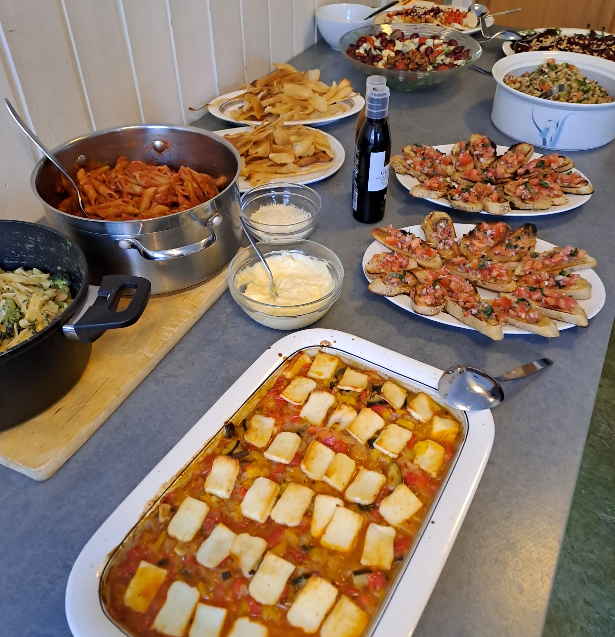
Recommended diet from the Directorate of Health
Choose fish and seafood, beans and lentils more often than red meat. (max 350g/ week)
Eat as little processed meat as possible.
Have a daily intake of milk and dairy products, and choose products with less fat.
Drink water as your main source of fluids
Notes:
Maks 300-400g rødt kjøtt pr uke
Beans and lentils are imported.

Slide 11
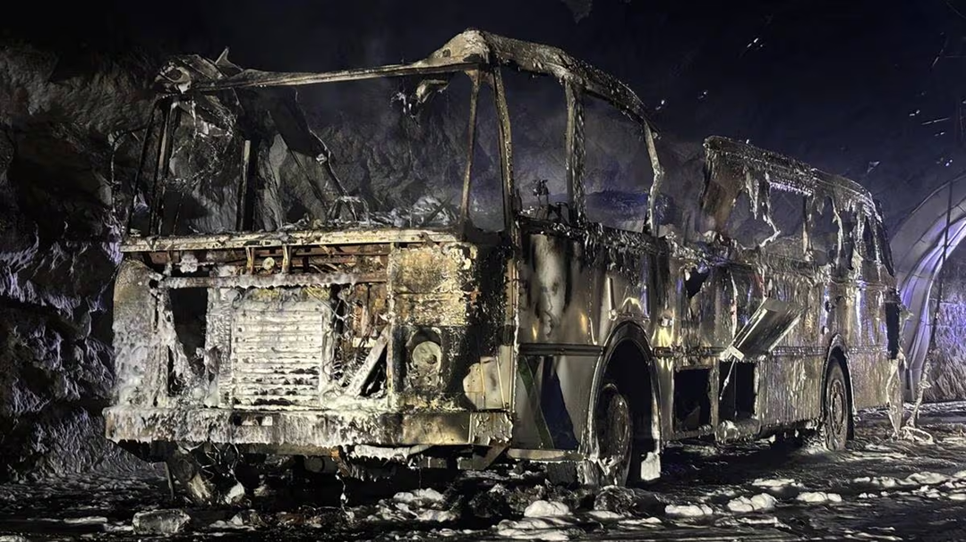
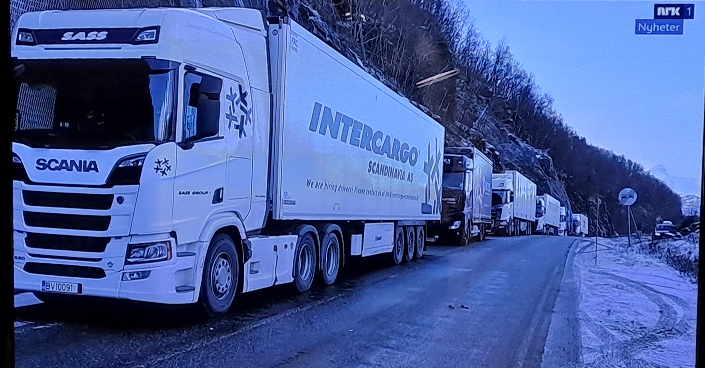
Vulnerabilities in communication between south and north
E6 is the main road between north and south,- few other roads (the railway only goes to Fauske and Bodø)
Two examples in recent times:
*a bridge in North Troms was destroyed by a flood in June 2021, and in June 2022, - detour via Finland
*a tunnel in Nordland was closed due to a bus fire in april 2026,- detour via Sweeden (takes 10 hours more)
In both cases, the E6 was closed for several days – and at big costs

Slide 12
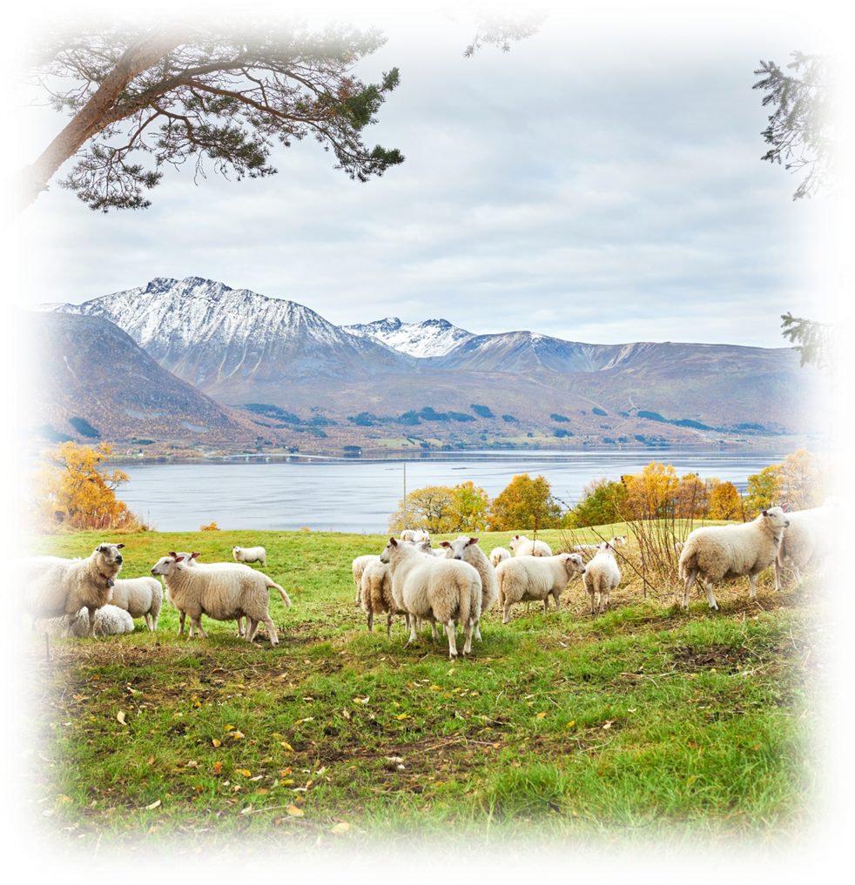
“Cannot get grain in a crisis”.
If Finnmark and Troms were to be isolated for a week, the food preparedness would be at the extreme.
In Finnmark, no one would be able to deliver eggs, vegetables or grain.
(The overview is calculated per week per person.
In addition, comes fish; wild fish and farmed fish))
In Finnmark, agriculture can contribute: In Troms, agriculture can contribute:
* 225 grams of meat + 250 grams of reindeer meat * 340 grams of meat + 10 grams of reindeer meat
* 9 grams of potatoes * 400 grams of potatoes
* 5 liters of milk * 3.62 liters of milk
* 0 eggs * 1 egg
* 0.1 grams of vegetables * 17 grams of vegetables, 17 grams of berries
* 0 grams of grain * 0 grams of grain
The County Governor of Troms and Finnmark: Matberedskapen i nord er sårbar ved krise | Statsforvalteren i Troms og Finnmark (16.09.2025)
Notes:
The State Administrator in Troms and Finnmark wants more focus on food security if a crisis were to strike over a longer period in Troms and Finnmark and has therefore prepared a document that shows what the population of Finnmark and Troms can get from agriculture if we were to become isolated. 16.09.2025 Food security in the north is vulnerable to crisis | State Administrator in Troms and Finnmark )

Slide 13
Differences between past food traditions and today's diet
Food traditions before: Food traditions now:
Short-distance/home-produced food . Lots of imports, international trends
Seasonal-dependent , "oranges for Christmas" . “Everything for all times"
Often large households, the young learned from the older . Small families, far away from family and traditions
Frugality, everything had to be used, cooked from scratch . Lots of fast food, produced "far away"
few and clean foods . More often ready-made food, "ultra-processed“
Notes:
Frugality= sparsommelighet

Slide 14
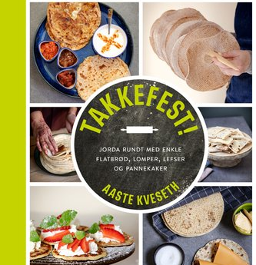
“Lefseskam”- lefse shame
The regret can be great for many who never took the opportunity and learned to make lefse from their grandmothers.
When faced with approximate recipes where you should use flour for the right dough, frustration increases. What is the right dough?
Norwegian-American Gary Legwold has named the condition lefse shame.
Gary himself has strong memories of his grandmother who made the world's best lefse. She died without him having learned how to make lefse from her. When he tried to make lefse and failed, it gave him a feeling of shame.

Slide 15
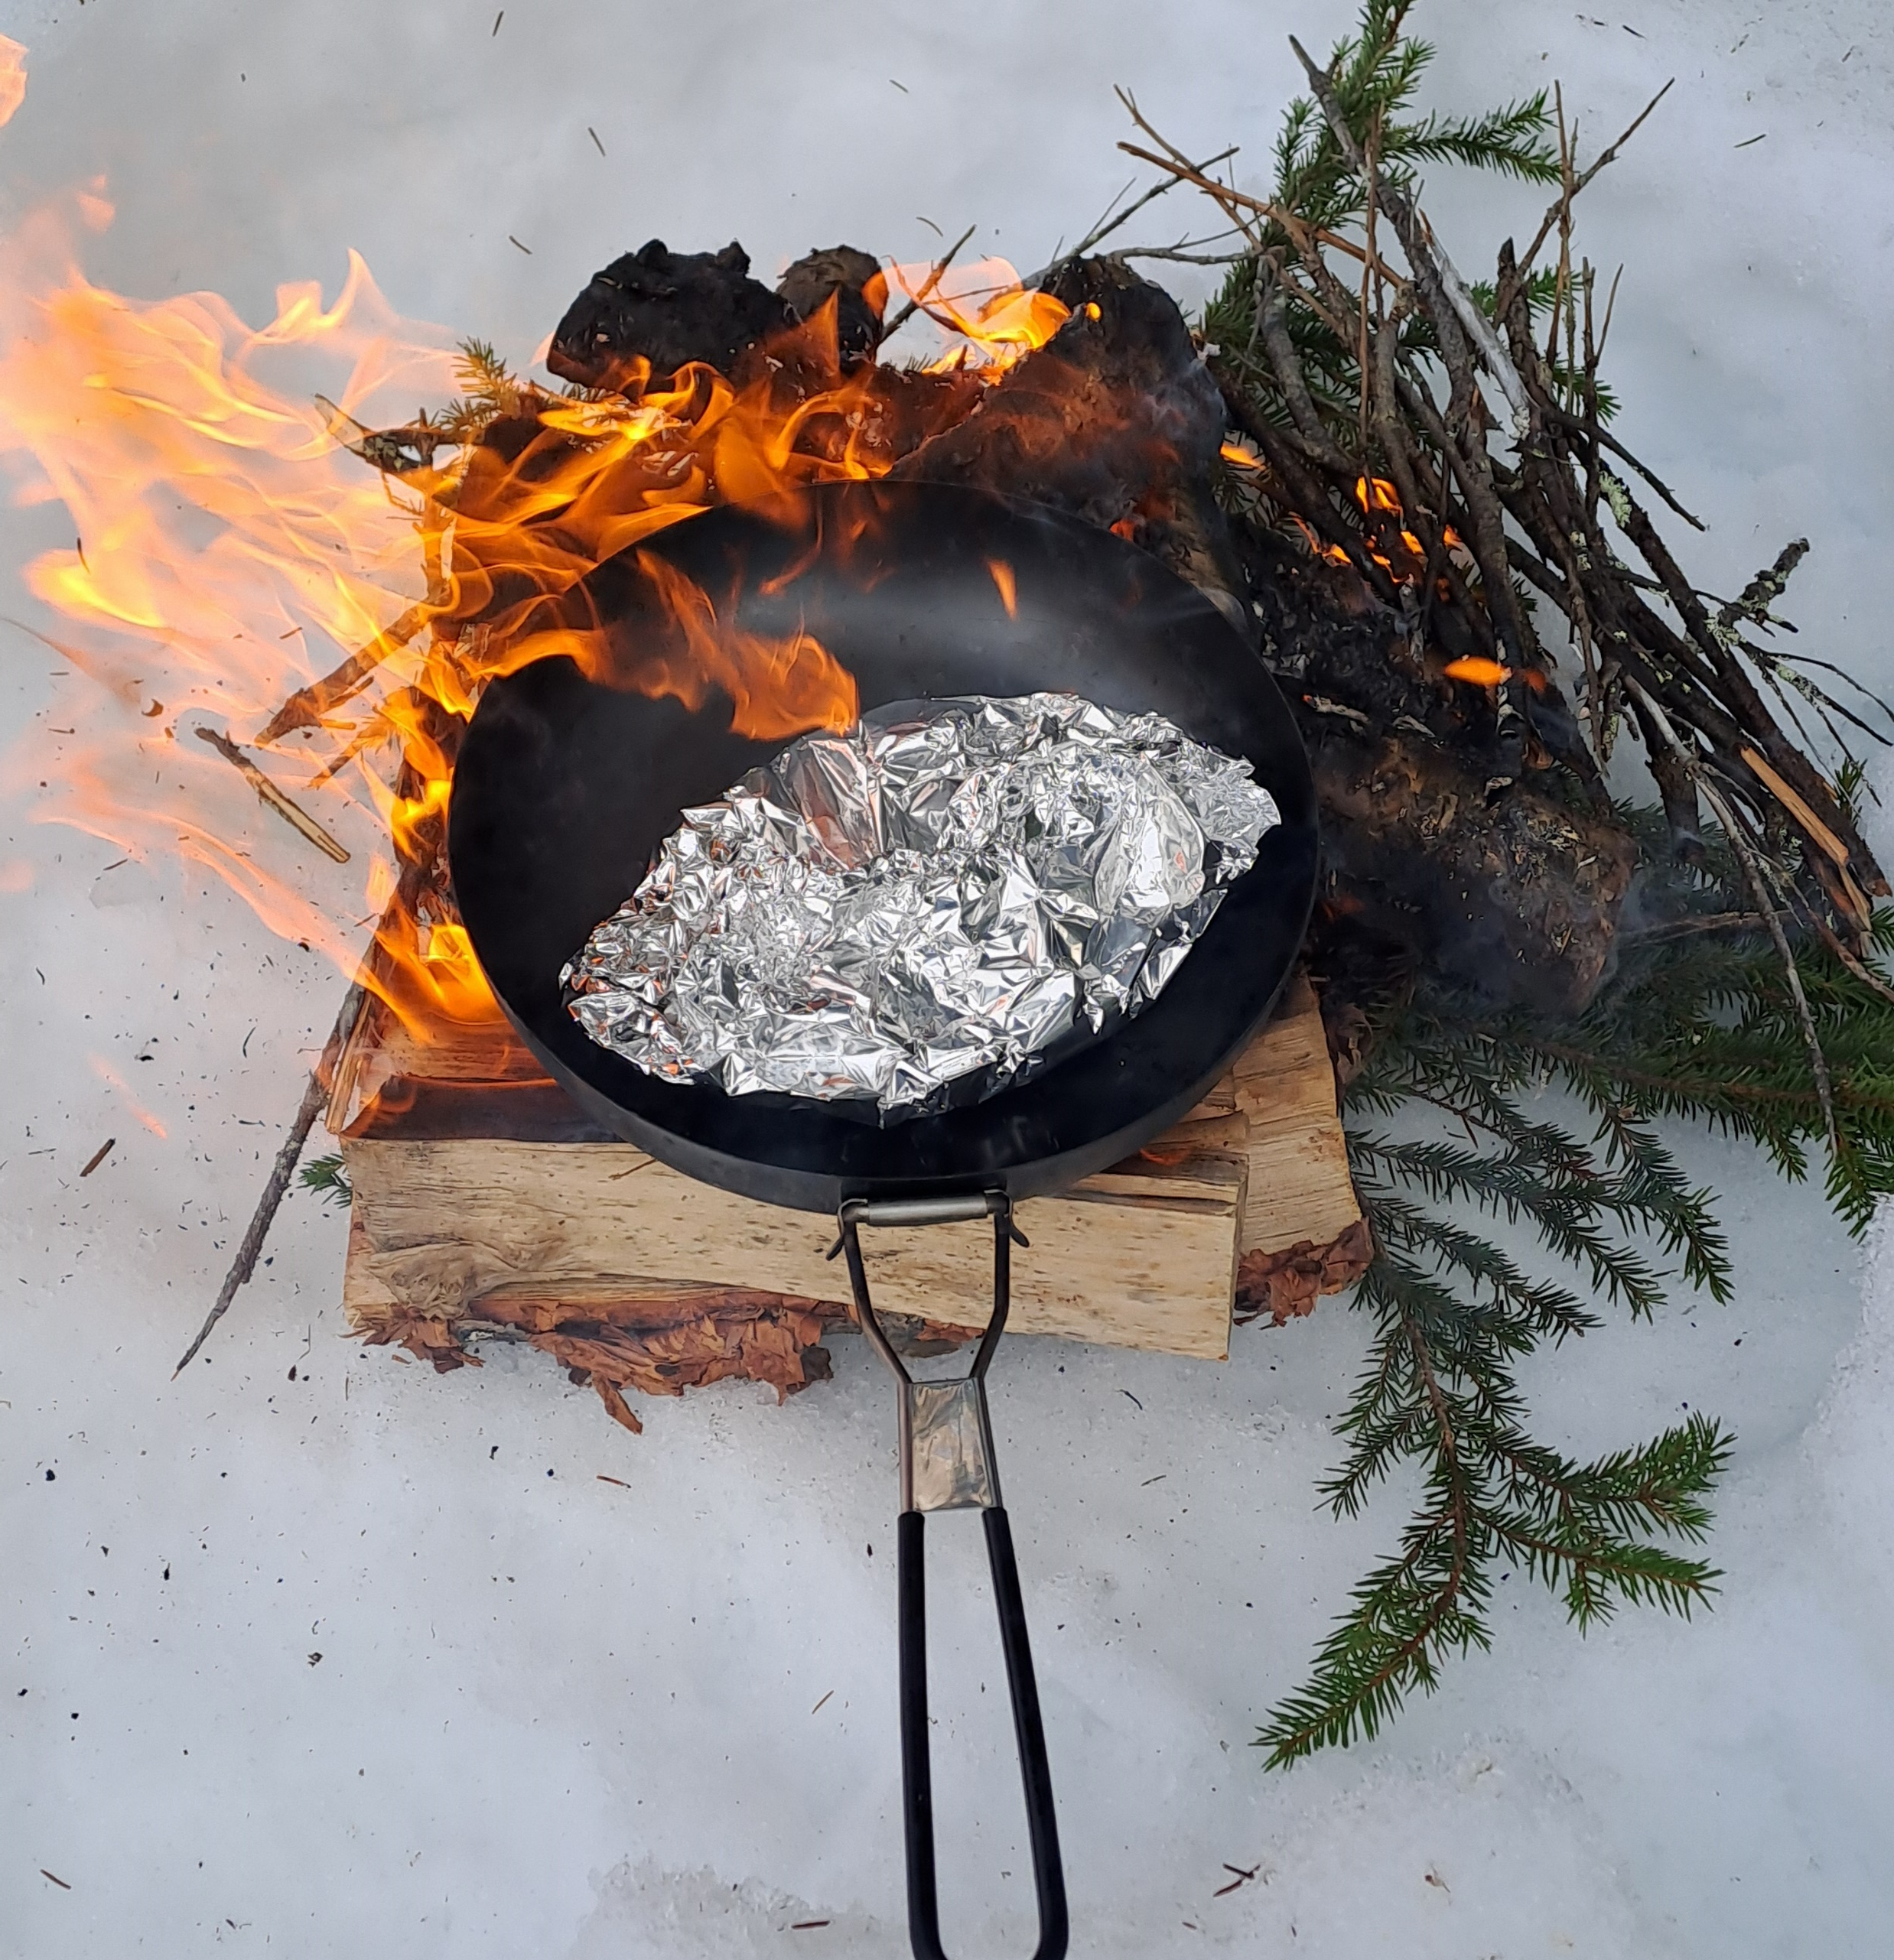
Preservation, and to cook without electricity
Knowledge ( and equipment) of different preservation methods: boiling, salting, drying, smoking, canning, pickling, juicing, fermentation, acidify/ souring of milk
knowledge of how to cook when the power goes out and the food in the freezer starts to thaw

Slide 16
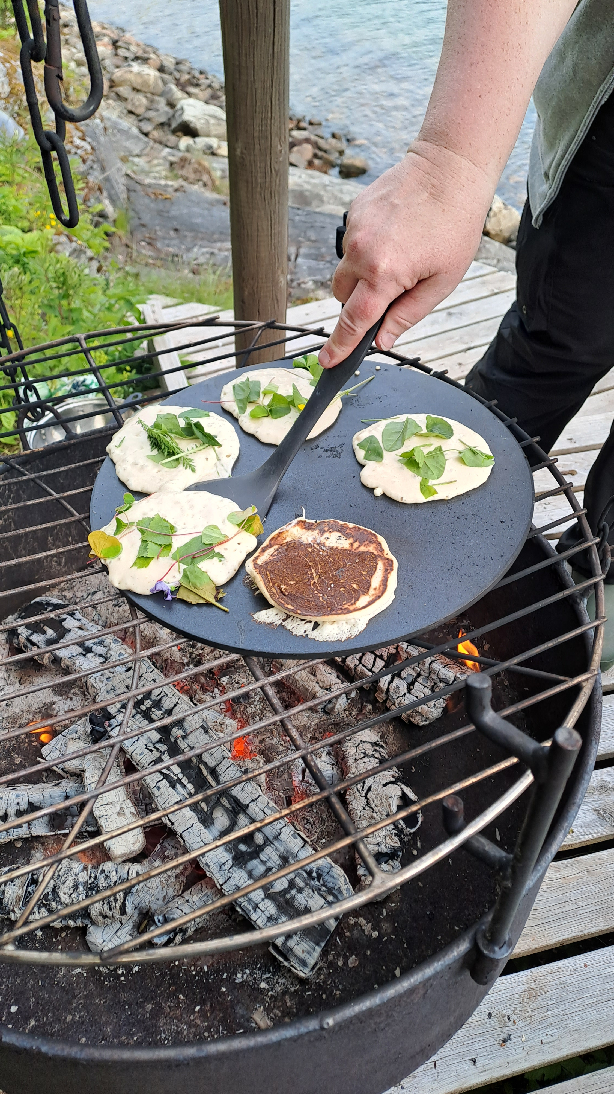
What to do:
Each individual:
Emergency stockpile in accordance with recommendations from the Directorate for Emergency Situations
Know the foods you have access to locally
Know how to use available food
Know how to preserve available food (cool storage)
Know how to cook without electricity
Know how to cultivate what you can where you live (potatoes)
Emergency friends
Social responsibility:
sufficient stock of key food items such as grains locally
alternative transport routes

Slide 17

Notes:
a little taste/ shot of rhubarb juice

Slide 18
Source references
Grøttland, Kristine Lind: “Daily bread, daily work”
https://norsktradisjonsmat.no (Norwegian traditional food; website with traditional food recipes)
The State Administrator in Troms and Finnmark; https://www.statsforvalteren.no/troms-finnmark/
The directorate of health, recommended diet: Kostrådene – Helsedirektoratet
The Norwegian Garden Society, - Climate zone map; Det norske hageselskap,- Klimasonekart
NRK/ Nordland politidistrikt ( https://www.nrk.no/nordland/e6-i-sorfold-stengt-etter-bussbrann-i-tunnel-1.17827182 )
DSB (Directorate for Civil Protection): https://www.dsb.no/sikkerhverdag/egenberedskap/

